Slide 1
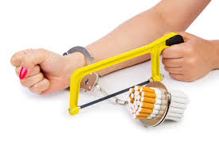
Smoking Cessation
LaTosha Phillips
King University
Notes:
Why is smoking cessation important? Let’s talk numbers 1st
Even though smoking has declined since 1965 from 41.9% to 18%; smoking is still the leading cause of preventable illness and death in the US
Even more staggering is that 7.1% of middle school children and 23.2% of HS children smoke
What does tobacco use cause?
Cancer, cerebro and cardio vascular disease, dental disease, GI disorders, Respiratory disease
Those who don’t stop smoking by the age of 35, 50% will die from a tobacco related disease

Slide 2
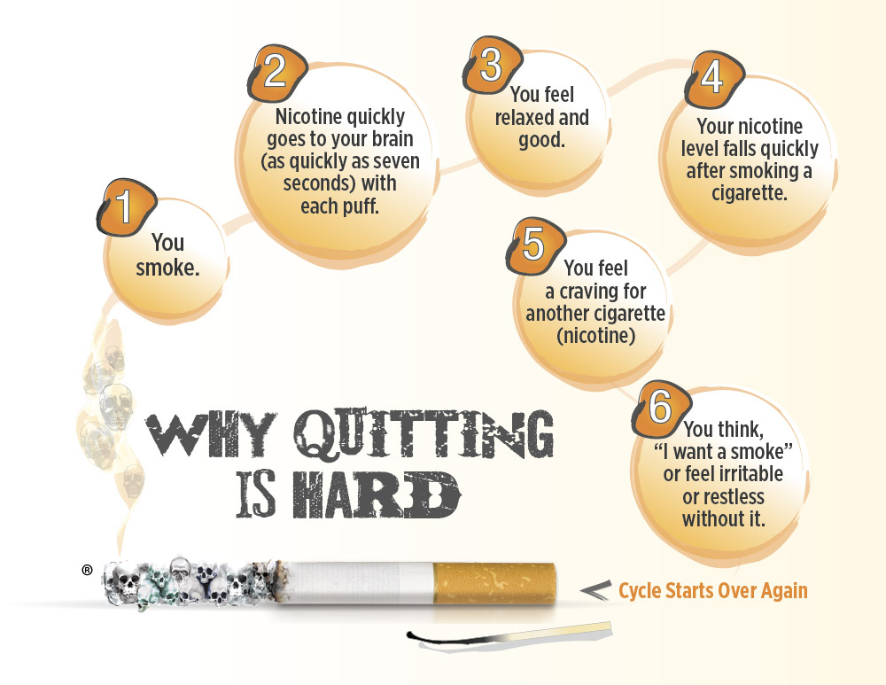
Pathophysiology of Nicotine
https://www.pimalung.com/pages/addiction.html
Notes:
Addiction:
We as providers have to understand addiction, to be able to help our patients quick smoking.
Nicotine is much like heroin, when it comes to the addictive components.
Never mind the hazardous chemicals such as ammonia, formaldehyde, carbon monoxide, benzene, arsenic, and lead.
Addiction is the compulsion to use a substance in the face of understanding the negative consequences that come along with it.
This is why tobacco use is the leading cause of preventable illness and death in the US.
If it was that easy to quit, these numbers wouldn’t be so high.
Nicotine Delivery:
After one puff, it just takes 10-15 seconds for the nicotine to enter the blood stream and reach the nicotine receptors in the brain
The mean time to peak concentration in the bloodstream is 7-8 minutes, this is maintained by each puff
This equates to 10puffs per cigarette, a pack a day, will provide the blood nicotine level to be reached 200 times per day = habit forming
Now, smokeless tobacco products are absorbed much slower in oral or nasal cavity
E-cigarettes eliminate the harmful tars and carbon-monoxide, from the typical tobacco use.
Some studies have shown that a regulation of nicotine content can help with smoking cessation, but there is still not enough studies done to endorse this as a treatment option.
Although the FDA and CDC have this on their radar.

Slide 3
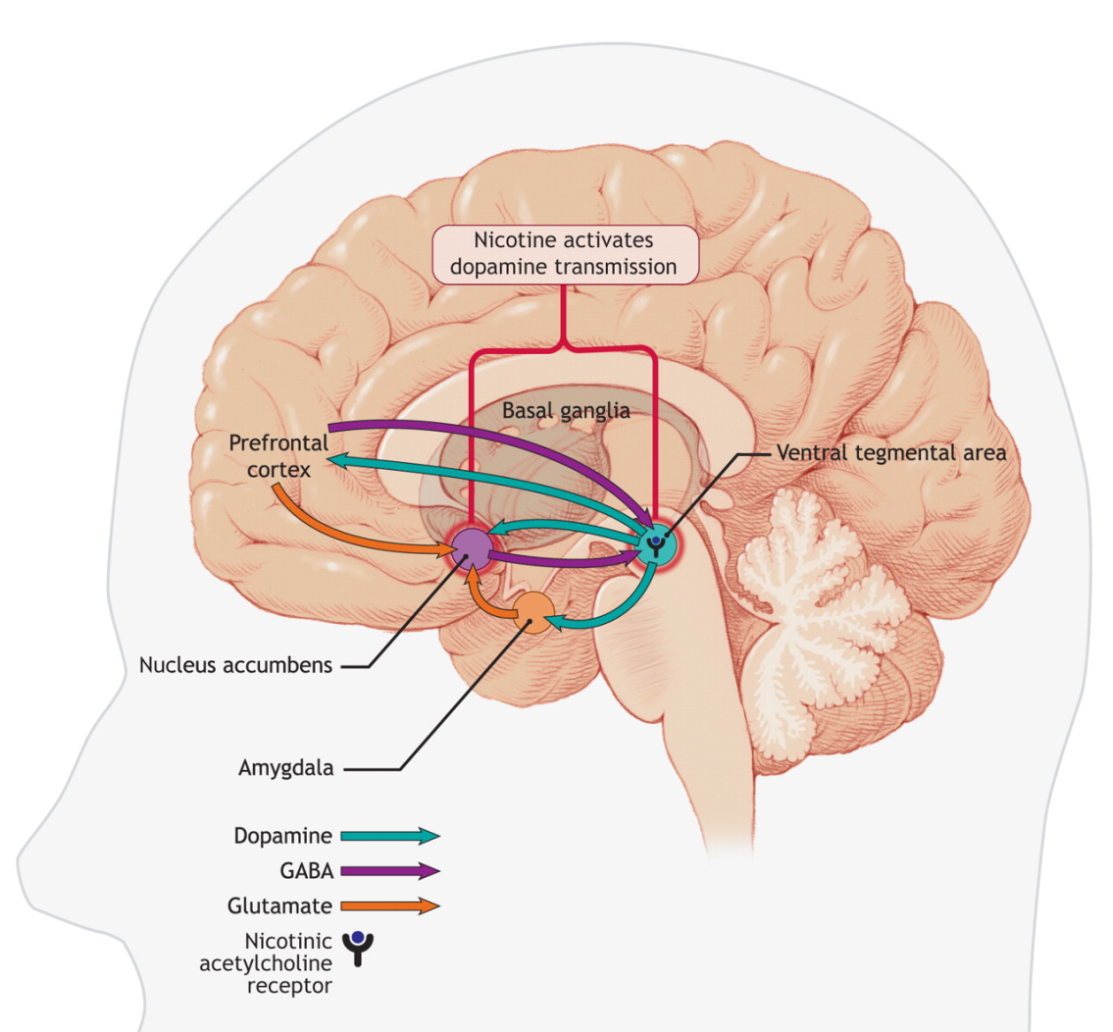
Nicotine Receptors in the brain
http://aaronhuertas.com/2015/06/08/quitting-smoking-nicotine-with-vaping-and-e-cigarettes-the-dilution-method-to-wean-myself-off-nicotine/
Notes:
Who knew we had nicotine receptors & they increase with chronic use of nicotine? No wonder, it’s so hard to kick the habit.
Nicotine acts as a stimulant as well as a depressant on the Central Nervous System.
The stimulant effects are mainly at the cortex which causes the person to have increased alertness & cognitive performance.
As nicotine activates the nucleus accumbens or “reward system” in the limbic system, this causes an increase in extracellular fluid dopamine levels.
This article: I’m not sharing this as an evidenced based treatment plan, I love how he titled the above picture “My dumb mammal brain, having a sweet, sweet nicotine party.”
I would think this is how my brain is on cookies, sweet tea, and carbs. If you read the entire article remember there’s a lot of this guys personality put into it, I do find it refreshing from crummy dry material. Just saying, but he does say “bullsocks” and there may be more.
I love a simplified Neuro explanation, any day.

Slide 4

Smoking vs Withdrawal Symptoms
http://drug.addictionblog.org/nicotine-withdrawal-symptoms/
Notes:
Nicotine Withdrawal Syndrome:
Craving
Nervousness
Irritability
Impatience
Hostility
Labile mood
Difficulty in concentrating
Restlessness
Anxiety
Then there’s the physical symptoms
Decreased heart rate
Increased appetite
Wt gain on average 8-11lbs
Somatic complaints
Myalgia
HA
Constipation
Fatigue
The lower the blood nicotine level, the urge to smoke is stronger.
How do you know you’re just smoking to keep from feeling like crap?
I don’t know about you, but I have enough trouble trying not to become the Hulk or Dr Jackal and Mr. Hide on a good day, just being a nurse, wife, mom, and the dreadful Grad student?

Slide 5

Goals of Treatment
http://www.mayo.edu/research/documents/tts-descriptionpdf/doc-10027328
Notes:
They have to be ready. They have to be able to fight the Hulk. No really, if they are ready they need to be managed by a tobacco treatment specialist or local tobacco quit line.
I didn’t find any local specific Tobacco treatment specialists listed, LinkedIn provided some outlying areas. Mayo clinic does offer a certification in this specialty. Just incase you’re interested, I provided the link to the explanation of what a tobacco treatment specialist is.
Actual referral to a treatment quit line, that will call the patient back has yielded better outcomes, than just providing the phone number and ask them to call themselves.
The actual goal of treatment is complete removal of tobacco in ones life. Either through cold turkey or with assistance of a pharmacological intervention
Successful treatment depends on the relationship between the pt and practitioner for proper use of treatment options
Treatment needs to include counseling, support groups, problem solving skills, relapse prevention, stress management to increase cessation rates.

Slide 6
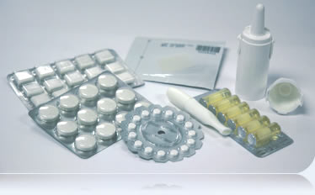
Pharmacological Interventions
Notes:
3 Different Treatment options
#1 Nicotine Replacement Therapy
#2 Antidepressant bupropion
#3 Nicotine Receptor partial Agonist Varenicline
Long term rates of smoking cessation are related to combination of bupropion and nicotine replacement such as patches or lozenges
Varenicline (Chantix) has a 43.9% rate of cessation after 9-12wks of use
#1 Nicotine Replacement : gum, lozenge, transdermal patch, inhaler, nasal spray
OTC options are :
Gum & Transdermal patch Nicotrol
Transdermal patch Habitrol
Lozenge Commit
Prescription:
Nicotrol inhaler
Nicotrol NS
This option is for pt who smoke more than a pack a day, especially within 30 min of waking, and those who attempted to stop previously but failed within the 1st wk
Nicotine polacrilex gum is Pregnancy Category C, Transdermal nicotine is Pregnancy Category D
Nicotine replacment therapy is contraindicated for those who have a hypersensitivity to nicotine, and used in caused with those who’ve recently had an MI or hx of arrhythmias
Gum has a really good cessation rate.
Adverse effects put this option not a first line choice for those who have TMJ disease or peptic ulcer dz. The nicotine polarilex is a nicotine resin complex that is slowing released from the gum when chewing 5-6 x’s then “parking” it in the buccal space. Slow buccal absorption over 30 min is best. Chewing faster or chewing while smoking can cause a nicotine toxicity; producing nausea & throat irritation. Within the 30 min polacrilex reaches it’s peak concentration.
A pt just beginning cessation tx should chew a 2-4mg tb every hr. The best results come from a schedule use every hr to 2hrs. If the pt smokes more than 25 cig/day, they should start on 4mg not to exceed 20 tabs/day of 4mg.
If the pt drinks acidic foods such as coffee, soda, juice it may interfere with buccal absorbption, so they should be taught to withhold 15min prior, during & after chewing.
After 6 wks of successful cessation, a gradual weaning is suggessted. Weeks 7-9, 1 tab, ever 2-4hrs. Wks 10-12, 1 tab, every 4-8hrs. After 12wks D/C gum, substitute sugarless gum.
Lozenge use is very similar to gum.
Nicotine Transdermal System:
This provides a slow cutaneous absorption of nicotine over many hours
Applied to clean, nonhairy skin of the upper body upon waking in the morning
Peak Nicotine levels are reached within 2-6hrs, then gradually decreases
Once removed, nicotine in bloodstream is non-detectable in 10-12hrs in nonsmokers
Different strengths available, and applied for 16-24hrs
Light to average smoker may start with a 16hr patch; but is not effective for early morning withdrawal effects.
24hr patch provides a steady-state blood level, with minimum peaks/troughs, and eliminates the morning withdrawal effects
This rate of cessation is usually doubles 6-12 month rates vs placebo
Once daily dosing. Weaning is a scheduling decrease in dosing.
Most important to caution is smoking while using the patch can cause life threatening dysrythmias or acute MI
Most common adverse effect is skin irritation, change site daily, rotate sites no less than a week apart.
Too high of a dose can cause the more skin irritation, also delayed in sleep onset. This is where selecting the correct dose for cessation as well as minimizing the adverse effects can get tricky for the provider and the pt.
Nicotine toxicity : HA, n/v (remove patch, flush area with water without soap)
Nicotine Nasal Spray:
1-2 sprays each nostril per hr, don’t exceed 5 doses (10sprays)/hr or 40doses (80sprays)/day
Rapid achievment of peak blood levels reached within 4-15min after 1mg (2spray)dose.
Used for the most severe withdrawal symptoms (most similar to smoking cigarettes)
May provide a more sense of control of symptoms
DO NOT INHALE, SWALLOW, OR SNIFF THE SPRAY, the most common adverse effect is nasopharyngeal & ocular mucosa irritation
As with nicotine relplacement can cause serious arrythmias , elevated BP, avoid after MI
Quicker abrupt discontinued safer with any cardiac symptoms, than the longer acting nicotine products.
Possible abuse for “head rush”, very similar to the “feel good” sensation from smoking a cigarette
Max length of tx should be 3 months
Nicotine inhaler:
Stimulates the act of smoking a cigarette
Pt puffs continuously on inhaler for 20min, proivdiding nicotine of 2 cigarettes
6 cartridges a day, for 3-6wks, max 16/day for first 12wks, after 12wks dose reduced gradually with max of 6 months of tx
Adverse effects : coughing, mouth & throat irritation, & dyspepsia
Antidepressants : Bupropion (Zyban)
Due to relationship between depressed mood and smoking behavior
Bupropion truly unsure why it helps with the abstaining from smoking (thought to have a weak inhibitor of neuronal uptake of dopamine & norepinephrine)
Started 1-2 wks before quit-smoking date
Starts on 150mg daily for 3 days, increased to BID at least 8hrs apart (not close to bedtime)
On quit day, possibly quit cold turkey or supplement nicotine replacement
Combo together, more successful than patch alone
Continue 7-12 wks, up to 6 months
If not quite by wk 7, not likely that this will work
Contraindicated in pts with seizures, bulimia, anorexia, and not within 14 days of MAOI use, hx of stroke, brain surgery, Closed head injury
Decreased doseing with pt with renal failure, drug metabolites may accumulate
Used in caution with pts hx of chirrohis, 150mg every other day instead
Pregnancy category C, not in children under 18
If used in combo with nicotine replacement, monitor closely for HTN
Don’t use with Wellbutrin, they have the same active ingredients (Wellbutrin has a Black box warning for increased risk of suicide)
Most frequent adverse effects are insomnia, dizziness, dry mouth, constipation (poss increase fiber & fluid intake)
Nicotinic Receptor Partial Agonists : Varenicline (chantix)
Just as the name suggessts it works on the receptors in the brain where nicotine likes to bind, by preventing the binding of nicotine less reward symptoms as well as decreased withdrawal symptoms
Pt chooses a quit date, start Chantix 1 wk prior , reaches steady state in 4 days, up it to 1mg BID as required, 0.5mg x once a day for 1st 3 days, then 0.5mg BID for days 4-7. 1mg BID day 8 throughout tx. Taken with full glass of water, with eating. Continue tx for 12 wks. If it’s working, continuation for 12 more wks is most likely full cessation.
Adverse reaction most common is nausea, insominia, ha, Possible changes in behavior such as agitation, depressed mood, suicidial behavior (not tested with those who have a pre-existing pscyhiatric disorder) Safety hasn’t been established.
Pregnancy Category C and not recommeded for pregnant or nsg women, not for children under 18, renally elimnated and needs to be used cautiously in elderly or decreased renal function.

Slide 7

Monitoring Cessation
Notes:
Signs of nicotine withdrawal, prevent relapsing & support for multiple attempts of quiting. Bheavior changes.
Smoking & nicotine can increase circulating cortisol & catecholamines. Adrenergic agonists or adrenergic blockers decrease their nicotine dependence. Smoking can reduce the effects of Lasix & reduce cardiac output, smoking cessation can reverse these actions. Glutethimide absorption may be decreased with smoking cessation. 1st pass metabolism of Darvocet may be decreased by smoking cessation. Smoking cessation potentiates theophylline insulin, pentazocine, oxazepam, tricyclic antidepressants, caffeine, & tylenol.
Pregnant women should abstain all together, nicotine replacement hasn’t been studied enough, if anything gum is to be used 1st
Children aren’t approved for treatment at all, toxic levels of nicotine are reached quickly.
Adolescents are the hardest to treat, minimal treatment options not enough studies, counseling is best, but a trial of nicotine replacement for those who smoke a pack a day, transdermal is the best choice of option.

Slide 8
Case Study
History of present illness: 19 year old female presents to the college clinic for help discussing options for quitting smoking. It started as a social cigarette with drinking occasionally, to ½ pack a day. She’s afraid of the long-term effects of smoking; her grandfather just died at 68 of lung cancer.
Past medical history: appendix removed at age 14, otherwise healthy
Family history: Mother suffers with depression, obesity, and HTN. Both parents were smokers in the home. Paternal grandfather died of lung cancer at age 68. Maternal grandmother is diabetic with extensive cardiac history.
Social History : occasional social drinking, recent increase from ½ pay of cigarettes a week, to ½ pack a day.
Allergies: NKDA
Current Medications: Motrin PRN aches/pains or headache, Benadryl PRN seasonal allergy symptoms, Depo-provera IM
VS: BP 175/60 Temp 98.6 HR 99 RR 18 Wt 200 Ht 5.5
Physical Exam: Alert and oriented, 19 y/o female, appropriately concerned about her health and future well-being. She’s moderately active with walking to classes, but decreased normal activity due to school work-load recently. Recent weight gain of 10lbs in the last 3 months reported. She denies any thoughts of depression or harm. She’s interested in looking into options for smoking cessation, as well as change in contraception if needed. She is willing to contact a support group for smoking cessation that includes teaching skills in stress management.
Labs: All lab values within normal range, Negative urine pregnancy.

Slide 9
Prescription
King College Clinic
1350 King College Rd
Bristol, TN 37620
Patient: Mary Katherine Jones Date:7/26/16
Dob: 7/1/1997
Rx: Nicoderm CQ (available OTC) 14mg/d patch
Sig: Low-dose regimen: 14mg/d for 6 wk, then 7mg/d for final 2-4 wk. Length of treatment: 8-12wks
#appropriate boxes for 12wks of treatment
Refills: 0 (check in with office every other week)
Signature: FNP

Slide 10
Questions
What impacts the success of smoking cessation by 16%?
What harmful components does the electronic cigarette eliminate from smoking cigarettes?
Why is understanding addiction so important for practitioners who are advising patient with smoking cessation?
What are some holistic measures that may help patients with smoking cessation?

Slide 11
References

